Slide 1

YouTube Song Analysis
Project 2
Aditya Rai

Slide 2
Objectives
Data Cleaning and Preparation
Stage 1
Exploratory Data Analysis
Stage 2
Content & Channel Analysis
Stage 3
Temporal Trends
Stage 4
User Engagement Insights
Stage 5

Slide 3
Stage 1
Stage 2
- Clean and preprocess the dataset, handling missing values or outliers.
- Convert relevant columns to appropriate data types.
- Explore patterns and distributions in view counts, like counts, and comments.
- Identify trends in the popularity and engagement of YouTube song videos.

Slide 4
Stage 3
Stage 4
- Analyze the distribution of videos across different channels.
- Identify popular tags and their correlation with view counts.
- Explore how YouTube song video metrics vary over time.
- Identify peak publishing times and their impact on engagement.

Slide 5
Stage 5
- Investigate relationships between likes, comments, and views.
- Identify factors influencing user engagement with YouTube song videos.
Deliverables:
- Interactive Power BI dashboards showcasing visualizations of YouTube song data trends.
- Reports detailing channel and content analysis, temporal trends, and user engagement insights.
- Recommendations for content creators and stakeholders to enhance YouTube song video performance.

Slide 6
Dashboard

Slide 7
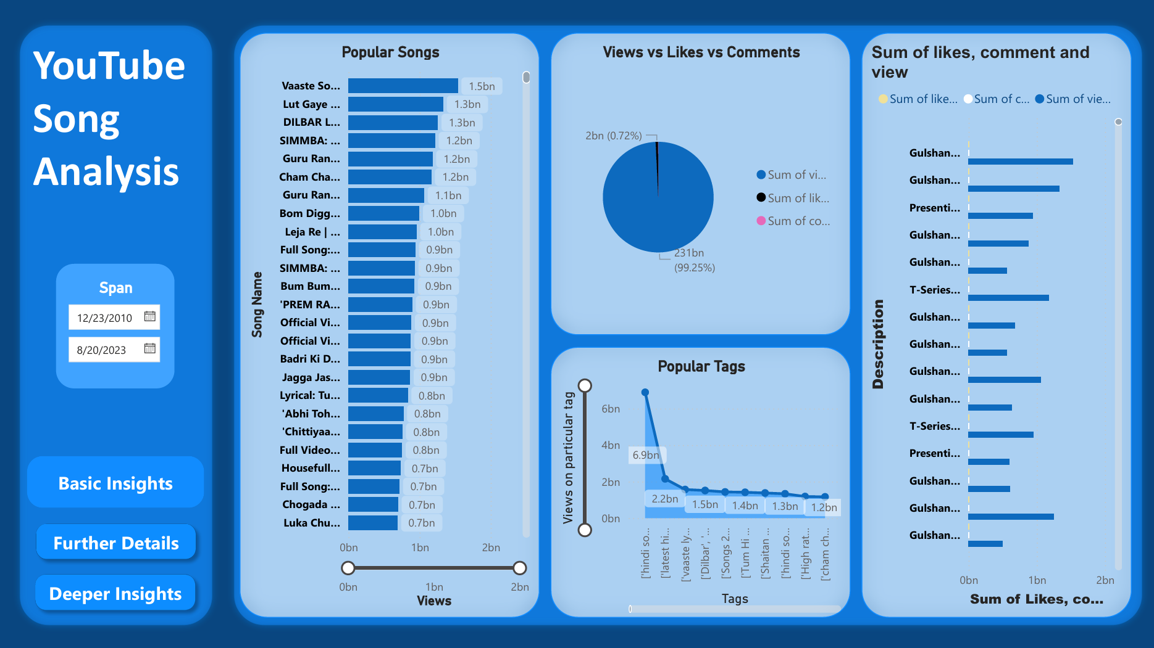

Slide 8
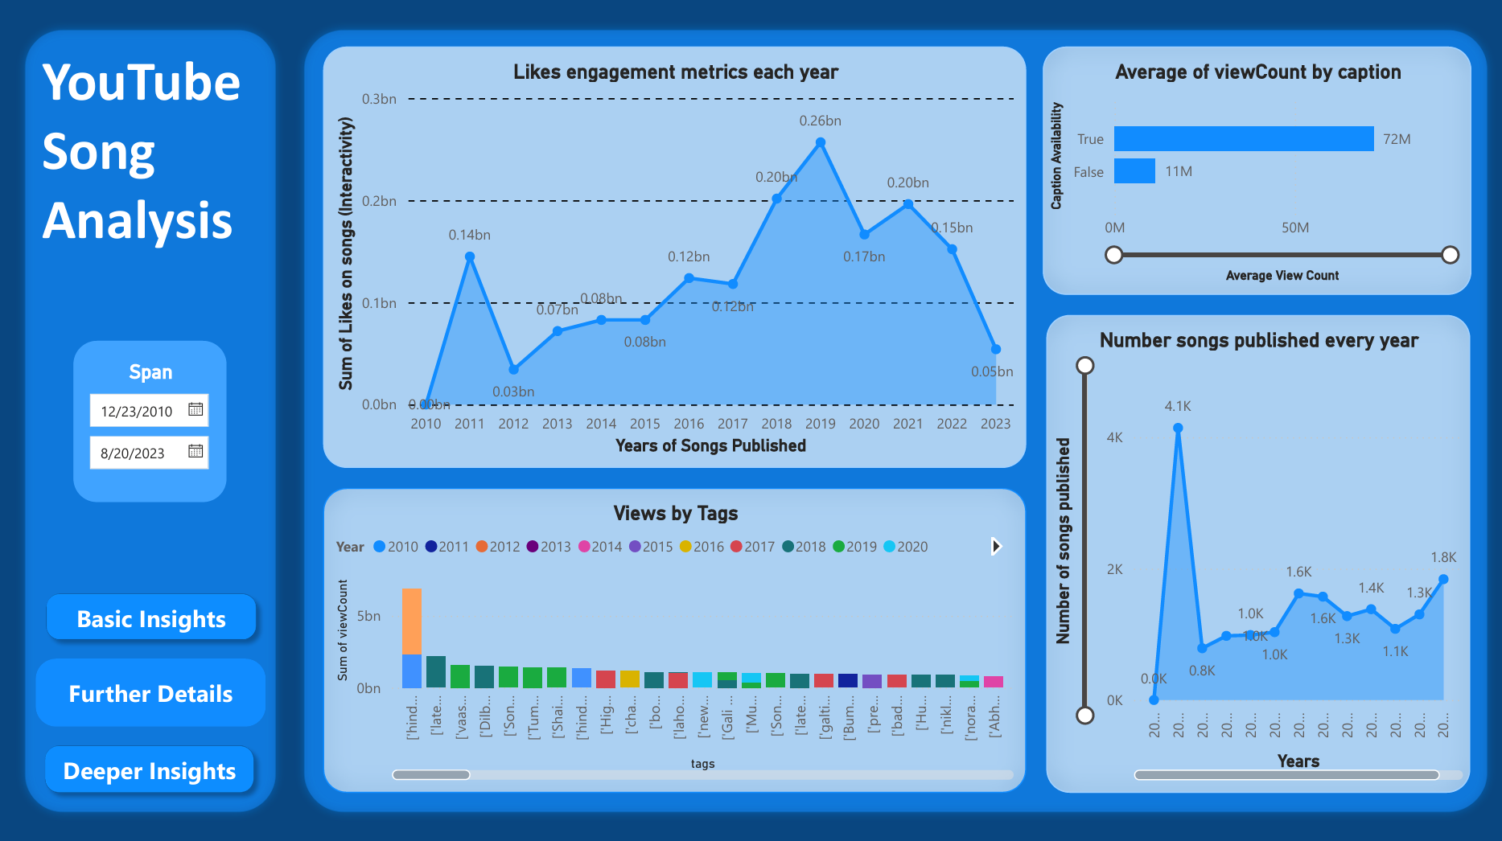

Slide 9
